Slide 1
FUTURE SALES PREDICTION
By Machine Learning Algorithm

Slide 2
2.1 PROBLEM DESCRIPTION:
The problem is to develop a predictive model that uses historical sales data to forecast future sales for a retail company. The objective is to create a tool that enables the company to optimize inventory management and make informed business decisions based on data driven sales predictions. This project involves data preprocessing, feature engineering, model selection, training, and evaluation.
2.2 DATASET INFORMATION:
We collected this dataset from Kaggle (https://www.kaggle.com/competitions/competitive-data-science-predict-future-sales/data) .
We also download it using
> kaggle competitions download -c competitive-data-science-predict-future-sales

Slide 3
2.3 DATASET COLUMNS :
ID : an Id that represents a (Shop, Item) tuple within the test set
shop_id : unique identifier of a shop
item_id : unique identifier of a product
item_category_id : unique identifier of item category
item_cnt_day : number of products sold. You are predicting a monthly amount of this measure
item_price : current price of an item
date : date in format dd/mm/yyyy
date_block_num : a consecutive month number, used for convenience.
item_name : name of item
shop_name : name of shop
item_category_name : name of item category

Slide 4
2.4.1 MODELS/LIBRARIES USED :
NumPy :
Purpose:
NumPy is a powerful numerical computing library in Python. It provides support for large, multi-dimensional arrays and matrices, along with mathematical functions to operate on these arrays.
Key Functions:
Efficient array operations and manipulation.
Mathematical functions for array operations.
Random number generation.

Slide 5
Pandas :
Purpose:
Pandas is a data manipulation and analysis library in Python. It provides data structures like Series and DataFrame for handling and analyzing structured data.
Key Functions:
Reading and writing various data formats (CSV, Excel, SQL, etc.).
Data cleaning, manipulation, and transformation.
Handling missing data and merging datasets.
Matplotlib :
Purpose:
Matplotlib is a popular 2D plotting library for creating static, interactive, and animated visualizations in Python.
Key Functions:
Creating line plots, scatter plots, bar plots, histograms, etc.
Customizing and styling plots.
Visualizing data distributions and trends.

Slide 6
Seaborn:
Purpose:
Seaborn is a statistical data visualization library based on Matplotlib. It provides a high-level interface for creating attractive and informative statistical graphics.
Key Functions:
Simplifies the creation of complex visualizations.
Enhances Matplotlib plots with additional styles and color palettes.
Visualizing statistical relationships in data.

Slide 7
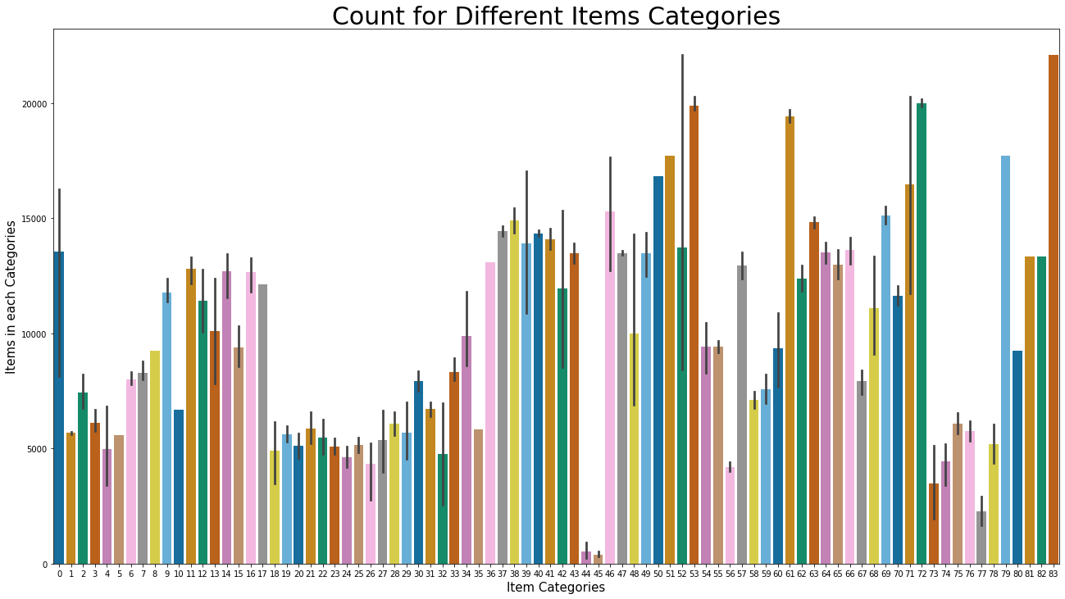
EXPLORING THE DATASET :
Fig.1. Plot of Item categories and the items in each categories

Slide 8
